Slide 1
Classification metrics

Slide 2
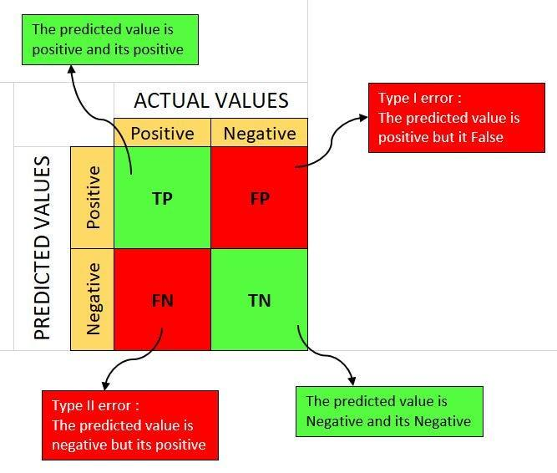
Confusion matrix

Slide 3
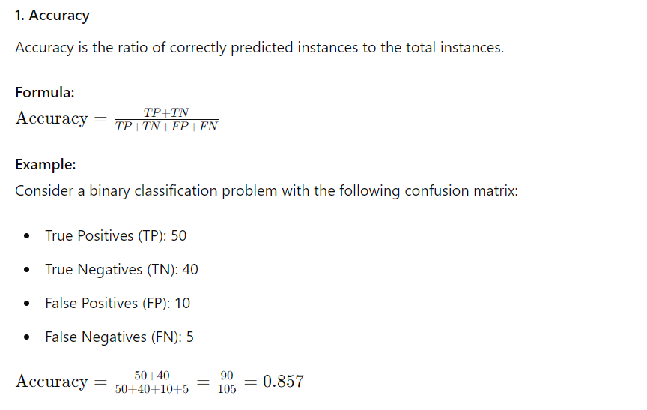

Slide 4
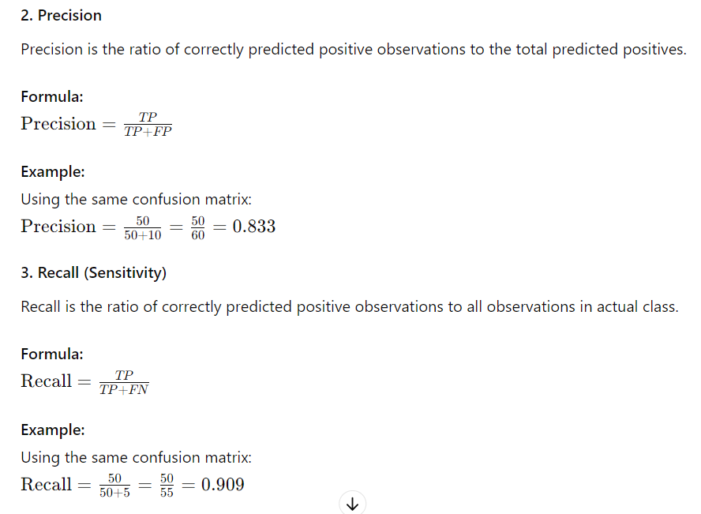

Slide 5
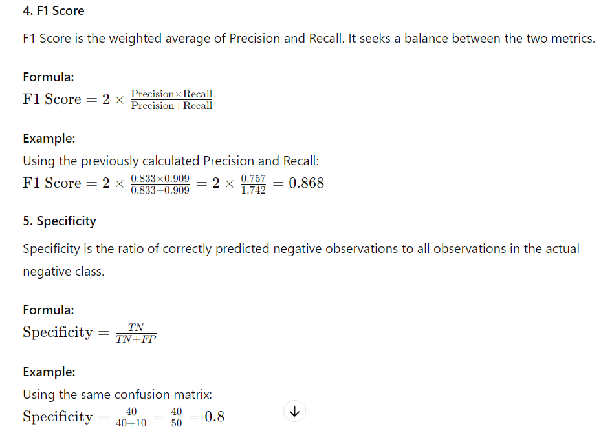

Slide 6
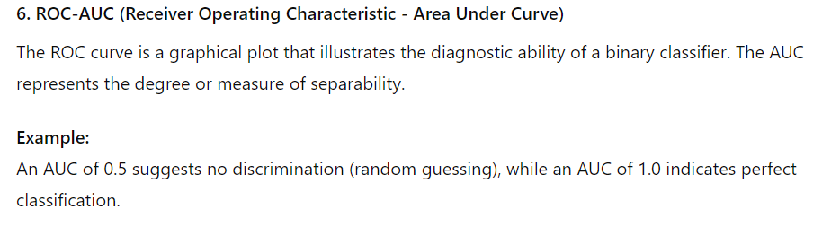
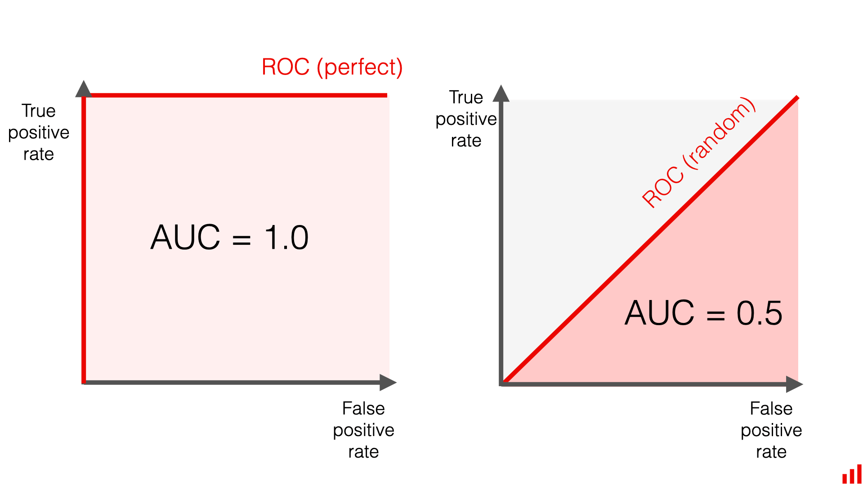

Slide 7
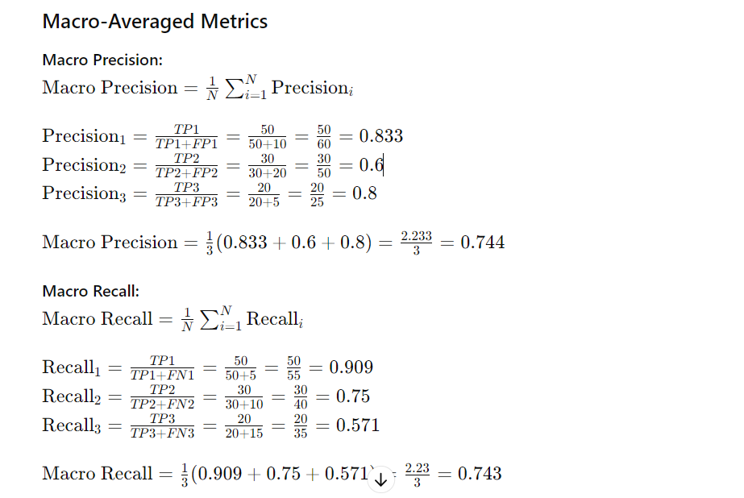
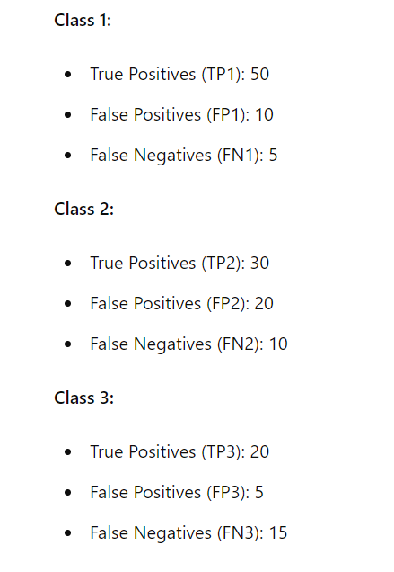
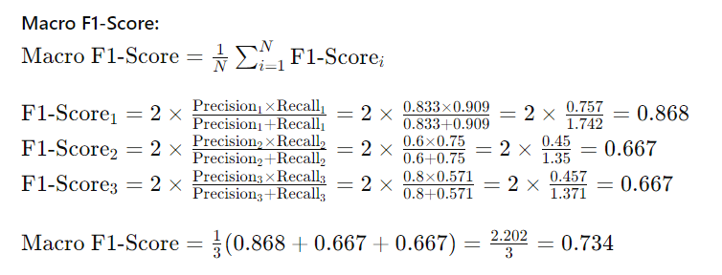
Macro, micro and weighted metrics

Slide 8
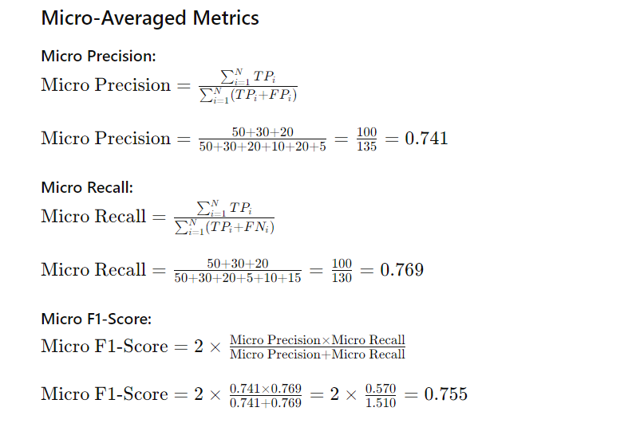
Macro, micro and weighted metrics

Slide 9
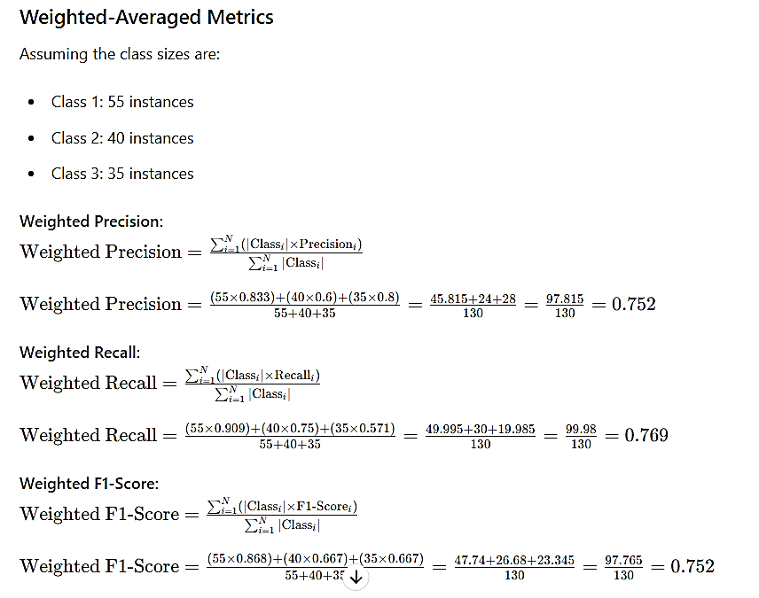
Macro, micro and weighted metrics

Slide 10
Summary
Macro Metrics:
Average of metrics calculated per class.
Treats all classes equally.
Micro Metrics:
Metrics calculated by aggregating true/false positives/negatives across all classes.
Reflects overall performance.
Weighted Metrics:
Metrics calculated per class and weighted by class size.
Reflects performance considering class distribution.

Slide 11
Example
Consider a dataset with three classes (A, B, C) with the following instance counts:
Class A: 100 instances
Class B: 10 instances
Class C: 5 instances
If a model performs poorly on Class C but well on Classes A and B, the choice of metric affects the evaluation:
Macro Metrics: Each class has equal weight, highlighting poor performance on Class C.
Micro Metrics: Performance on Class C is diluted تخفف by the larger number of instances in Classes A and B.
Weighted Metrics: Performance is influenced by the size of each class, giving more weight to Class A.
In conclusion, the choice between macro, micro, and weighted metrics depends on the specific evaluation needs and the class distribution in your dataset.

